Slide 1

CSE 591 Animation
Ross Maciejewski
rmacieje@asu.edu

Slide 2
Definition
Animation
Rapid successive display of many display frames where objects change position/appearance gradually so as to create the illusion of continuous movement
Where in InfoVis might animation be useful?
* - Material borrowed from John Stasko’s lecture on Animation: http://www.cc.gatech.edu/~stasko/7450/Notes/animation.pdf

Slide 3
Dynamic Information
Monitoring dynamic information can be cognitively strenuous
User must examine display and decided whether it has change
Often is preferable to explicitly alert user to a change by some sort of signal
Change empty mailbox icon to full
Adding motion to an icon

Slide 4
Use
Possibilities
Use time as an option for space, show how things change and move over time allowing us to show more data
To draw attention to something
As a visual encoding of particular variable values
To help transition between views
* - Material borrowed from John Stasko’s lecture on Animation: http://www.cc.gatech.edu/~stasko/7450/Notes/animation.pdf
Notes:
Bertan's variables
Wilkinsons' variables

Slide 5
Perception
Animation is a very strong visual attention mechanism
It is difficult to focus on other items when animation is nearby
There have been a variety of user studies on perception
Some studies indicate that motion triggers a kind of orienting response attracting a user’s attention¹
Motion compares favorably to color and shape in terms of attracting attention
Research also found that motion cues seem independent of color and shape cues² (motion may provide an extra dimensionality to the display)
- Material borrowed from John Stasko’s lecture on Animation: http://www.cc.gatech.edu/~stasko/7450/Notes/animation.pdf
1 - Faraday, P., Sutcliffe, A., 1997. Designing effective multimedia presentations. In:Proceedin gs of ACM CHI ’97. ACM, New York, pp. 272–279.
2 - Bartram, L., Ware, C., 2002. Filtering and brushing with motion. Journal of Information Visualization 1, 66–79.

Slide 6
Moticons
Moticons – Icons with motion
How well do people detect and identify them?
Are they distracting?
Motivation
Empirical investigation of the effects of moticons as notification mechanism in a peripheral environment
Three experiments
Experiment 1: Detection
Experiment 2: Identification
Experiment 3: Distraction
Lyn Bartram, Colin Ware, Thomas W. Calvert: Moticons: : detection, distraction and task. Int. J. Hum.-Comput. Stud. 58(5): 515-545 (2003)

Slide 7
Experiment 1: Detection
Goal
Color vs. Motion
Detection error rates and detection time
Signal cues
Color change: Green, Red
Two motion types: High Amplitude, Low Amplitude
Task
Detect any cue changes while performing a given primary task
Lyn Bartram, Colin Ware, Thomas W. Calvert: Moticons: : detection, distraction and task. Int. J. Hum.-Comput. Stud. 58(5): 515-545 (2003)

Slide 8
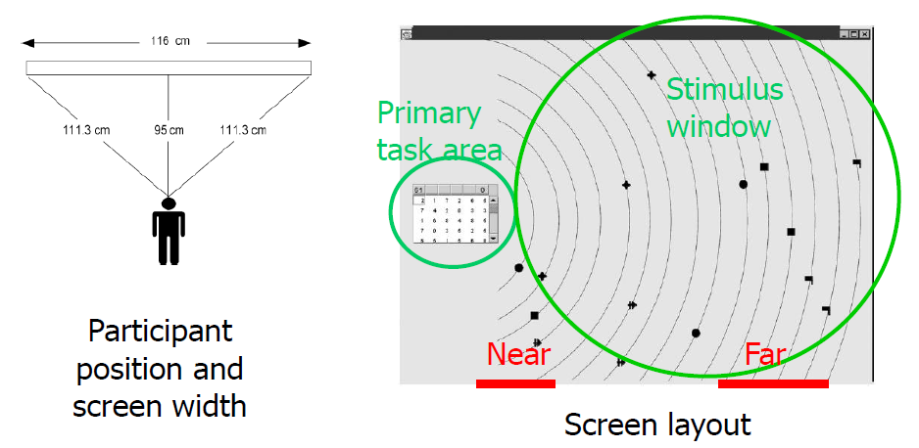
Experiment 1: Detection
Lyn Bartram, Colin Ware, Thomas W. Calvert: Moticons: : detection, distraction and task. Int. J. Hum.-Comput. Stud. 58(5): 515-545 (2003)

Slide 9
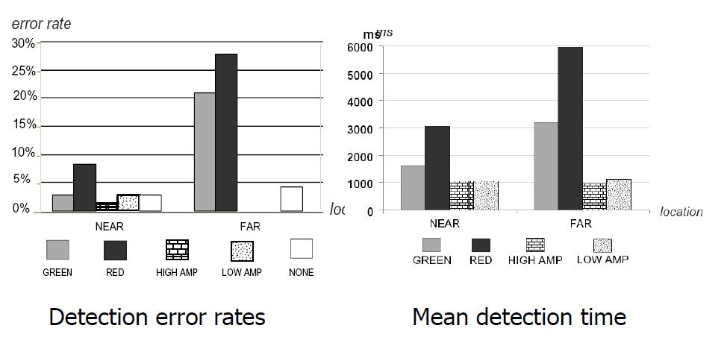
Experiment 1: Detection
Lyn Bartram, Colin Ware, Thomas W. Calvert: Moticons: : detection, distraction and task. Int. J. Hum.-Comput. Stud. 58(5): 515-545 (2003)

Slide 10
Experiment 2: Identification
Goal
In the real world, displays are crowded with multiple colors and shapes
Identify which visual element on the screen changed and thus which event the signal represents
Signal Cues
Color change
Shape change
Four motion types: Smooth linear, jumpy linear, smooth zoom, jumpy zoom
Lyn Bartram, Colin Ware, Thomas W. Calvert: Moticons: : detection, distraction and task. Int. J. Hum.-Comput. Stud. 58(5): 515-545 (2003)

Slide 11
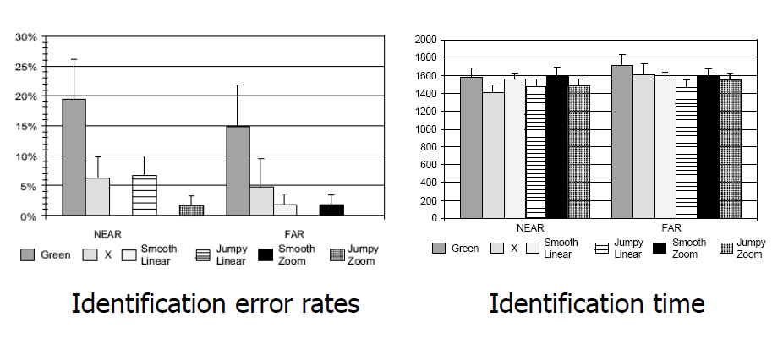
Experiment 2: Identification
Lyn Bartram, Colin Ware, Thomas W. Calvert: Moticons: : detection, distraction and task. Int. J. Hum.-Comput. Stud. 58(5): 515-545 (2003)

Slide 12
Experiment 3: Distraction
Goal
Evaluate the distraction and irritation properties of moticons in the desktop environment under different task conditions
Tasks
Browsing and studying on-line text
Playing FreeCell
Playing Tetris
Motion Cues
Linear
Zoom
Blink
Travel
Lyn Bartram, Colin Ware, Thomas W. Calvert: Moticons: : detection, distraction and task. Int. J. Hum.-Comput. Stud. 58(5): 515-545 (2003)

Slide 13
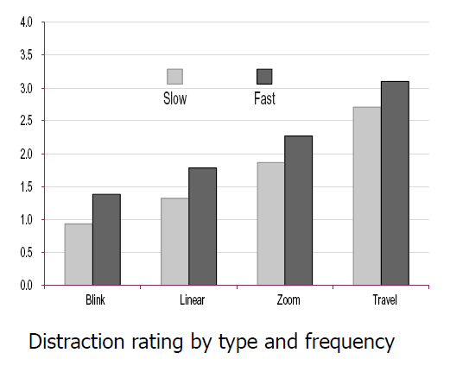
Experiment 3: Distraction
Lyn Bartram, Colin Ware, Thomas W. Calvert: Moticons: : detection, distraction and task. Int. J. Hum.-Comput. Stud. 58(5): 515-545 (2003)

Slide 14
Conclusions
Motion is a strong peripheral cue
Useful for searching and identifying things
But it can be distracting
* - Material borrowed from John Stasko’s lecture on Animation: http://www.cc.gatech.edu/~stasko/7450/Notes/animation.pdf

Slide 15
Animation for Transitions
Can animation help “soften the blow” when a view changes?
Animation preserves context by allowing the viewer to track where things on the screen went
So what kinds of animations are most effective?
* - Material borrowed from John Stasko’s lecture on Animation: http://www.cc.gatech.edu/~stasko/7450/Notes/animation.pdf

Slide 16
Suite of Transitions
Heer and Robertson developed and explored a variety of different transitions and applications
Performed experiments to see how these are perceived
http://www.youtube.com/watch?v=vLk7mlAtEXI
Discussion
What types of animation did they use?
How did they use animation?
J. Heer and G. Robertson. "Animated Transitions in Statistical Data Graphics," IEEE Transactions on Visualization and Computer Graphics Vol. 13, No. 6, Nov.-Dec. 2007, pp. 1240-1247.

Slide 17
Transition Types
View transformation
Substrate transformation
Filtering
Ordering
Timestep
Visualization change
Data schema change
J. Heer and G. Robertson. "Animated Transitions in Statistical Data Graphics," IEEE Transactions on Visualization and Computer Graphics Vol. 13, No. 6, Nov.-Dec. 2007, pp. 1240-1247.

Slide 18
Design Principles
Congruence (mental matching)
Maintain valid data graphics during transitions
Use consistent syntactic-semantic mappings
Respect semantic correspondence
Avoid ambiguity
Apprehension (easily perceivable)
Group similar transitions
Minimize occlusion
Use simple transitions
Use staging for complex transitions
Make transitions as long as needed, but not longer
J. Heer and G. Robertson. "Animated Transitions in Statistical Data Graphics," IEEE Transactions on Visualization and Computer Graphics Vol. 13, No. 6, Nov.-Dec. 2007, pp. 1240-1247.

Slide 19
Experiments
Track object across transitions
Animation beats no-animation, staged animation better than no staging
Estimate changing values
Animation generally better
Subjective
Staged animation preferred over basic animation preferred over static images

Slide 20
Telling the Story
Can animation help explain data?
Traditional use
Temporal data – Use animation to show changes in time
Often seen in geographical systems
What are the potential problems in geographical systems?
* - Material borrowed from John Stasko’s lecture on Animation: http://www.cc.gatech.edu/~stasko/7450/Notes/animation.pdf

Slide 21
Choropleth Map Classification
For purely spatial data, we talked about methods of classifying data for mapping
What happens when the data is spatiotemporal?
One of the most common ways of displaying spatiotemporal data is through the use of animation
Time is perceived to move in a linear fashion, we can animate graphics in a linear fashion to show movements/trends over time?
Now choice of class intervals must work not only across one map, but across all maps over our time range

Slide 22
Issues of Change Detection in Animated Choropleth Maps
Primary goal of animated maps is to depict change over time and space
Different types of maps will show animation with a different visual modality
Choropleth maps would show changes of color
Proportional symbol maps would show changes of size
A well designed animation should enable us to visualize dynamic processes more effectively
Goldsberry, K., and Battersby, S. (2009) Issues of Change Detection in Animated Choropleth Maps. Cartographica, 44(4): 201-215

Slide 23
Issues of Change Detection in Animated Choropleth Maps
However, research in cartography¹ and psychology² has shown that humans have a difficult time understanding animation
This is due to the fleeting nature of dynamic displays
Increased cognitive load trying to remember things and track changes
Research suggests that there is a potential for change blindness in animated choropleth maps
Challenges of split attention make it difficult to perceive multiple changes simultaneously
1 - MacEachren, A.M. 1995. How Maps Work. New York: Guilford.
2 - Tversky, B., J. Bauer Morrison, and M. Betrancourt. 2002. ‘‘Animation: Can It Facilitate?.’’ International Journal of Human–Computer Studies 57: 247–62.

Slide 24
GapMinder
http://www.gapminder.org/videos/200-years-that-changed-the-world-bbc/
Discussion:
Did the animation really add value to the visualizations?
Was it Rosling’s speaking that makes it compelling?
* - Material borrowed from John Stasko’s lecture on Animation: http://www.cc.gatech.edu/~stasko/7450/Notes/animation.pdf

Slide 25
Empirical Study
Work by Robertson et al. explored whether animated bubble charts are beneficial for analysis and presentation
Ran an experiment to evaluate the effects of animation
Experiment Design
3(animation types) x 2(data size: small and large) x 2(presentation vs. analysis)
Presentation vs. analysis between subjects
Others – within subject
Animation has 1-second default time, but user could control time slider
George G. Robertson, Roland Fernandez, Danyel Fisher, Bongshin Lee, John T. Stasko: Effectiveness of Animation in Trend Visualization. IEEE Trans. Vis. Comput. Graph. 14(6): 1325-1332 (2008)

Slide 26
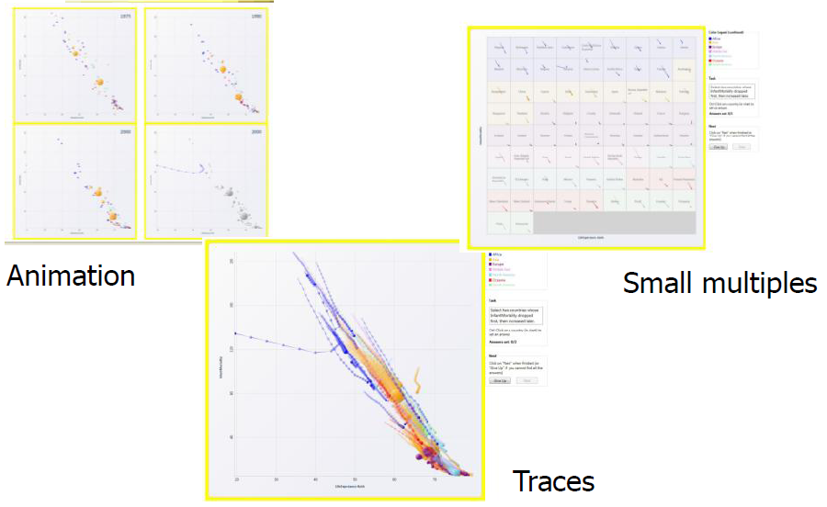
Visualizations Studied
George G. Robertson, Roland Fernandez, Danyel Fisher, Bongshin Lee, John T. Stasko: Effectiveness of Animation in Trend Visualization. IEEE Trans. Vis. Comput. Graph. 14(6): 1325-1332 (2008)

Slide 27
Experiment Design
Data
UN data about countries
Tasks
24 tasks, 1-3 require answers
Select 3 countries whose rate of energy consumption was faster than their rate of GCP per capita growth
Select 2 countries with significant decreases in energy consumption
Which continent had the least changes in GCP per capita
George G. Robertson, Roland Fernandez, Danyel Fisher, Bongshin Lee, John T. Stasko: Effectiveness of Animation in Trend Visualization. IEEE Trans. Vis. Comput. Graph. 14(6): 1325-1332 (2008)

Slide 28
Conditions
Analysis – straightforward, interactive
Presentation
6 participants at a time
Presenter described a trend relevant to task, but different
No interaction with system
In animated condition, participants saw last frame of animation (no interaction)
George G. Robertson, Roland Fernandez, Danyel Fisher, Bongshin Lee, John T. Stasko: Effectiveness of Animation in Trend Visualization. IEEE Trans. Vis. Comput. Graph. 14(6): 1325-1332 (2008)

Slide 29
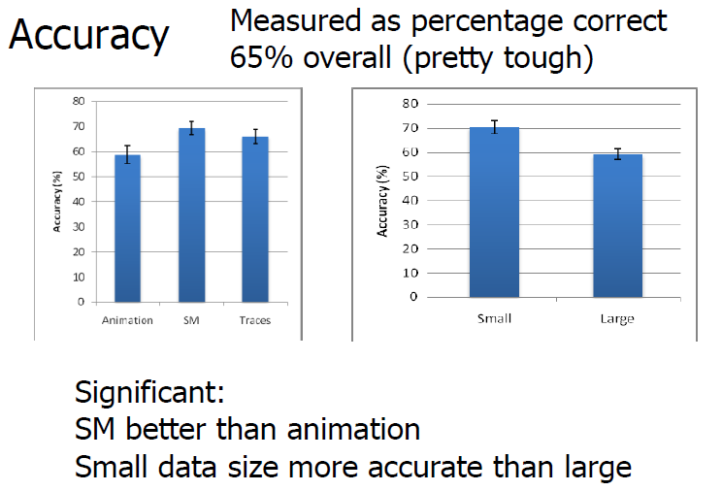
Results
George G. Robertson, Roland Fernandez, Danyel Fisher, Bongshin Lee, John T. Stasko: Effectiveness of Animation in Trend Visualization. IEEE Trans. Vis. Comput. Graph. 14(6): 1325-1332 (2008)

Slide 30
Results
Speed
Presentation
Animation faster than small multiples and traces
15.8 seconds vs. 25.3 seconds vs. 27.8 seconds
Analysis
Animation slower than small multiples and traces
83.1 seconds vs. 45.69 seconds vs. 55.0 seconds
George G. Robertson, Roland Fernandez, Danyel Fisher, Bongshin Lee, John T. Stasko: Effectiveness of Animation in Trend Visualization. IEEE Trans. Vis. Comput. Graph. 14(6): 1325-1332 (2008)

Slide 31
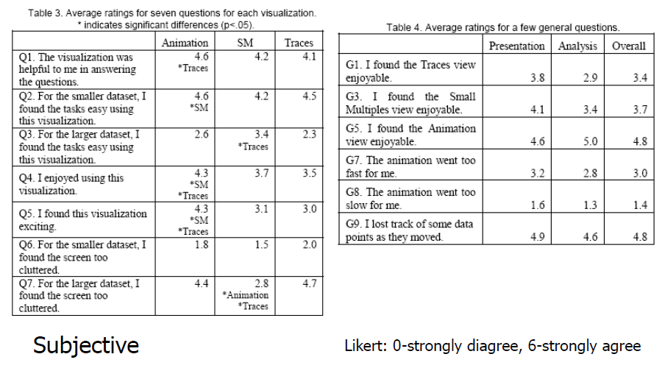
Results
George G. Robertson, Roland Fernandez, Danyel Fisher, Bongshin Lee, John T. Stasko: Effectiveness of Animation in Trend Visualization. IEEE Trans. Vis. Comput. Graph. 14(6): 1325-1332 (2008)

Slide 32
Results
G13: Which visualization did you prefer for the small dataset?
G14: For the large?
Presentation, small: Animation (9) > SM (6) > Traces (3)
Presentation, large: Traces (8) > SM (6) > Animation (4)
Analysis, small: Animation (7) > SM (6) > Traces (5)
Analysis, large: Animation (8) > SM (6) > Traces (4)
George G. Robertson, Roland Fernandez, Danyel Fisher, Bongshin Lee, John T. Stasko: Effectiveness of Animation in Trend Visualization. IEEE Trans. Vis. Comput. Graph. 14(6): 1325-1332 (2008)

Slide 33
Discussion
People rated animation more fun, but small multiples was more effective
As data grows, accuracy becomes an issue
Traces and animation get cluttered
Small multiples get tiny
Animation
Fun, exciting, emotionally touching
Confusing, the dots flew everywhere

Slide 34
Does Animation Help?
With Java, Flash, JavaScript, etc. on the Web, distributing animated, interactive visualizations is easier than ever
So, if you have a static visualization, can you think of ways to animate it and make it more dynamic?
Will this make it more effective?
If a 2D image is good, then a moving image is better, right?
Jonathan Harris and Sep Kamvar’s We Feel Fine: http://wefeelfine.org
Fisher, Danyel, “Animation for Visualization: Opportunities and Drawbacks”, Ch. 19 in Steele & Iliinsky (eds.), Beautiful Visualization (Cambridge: O’Reilly, 2010), pp.329-352.

Slide 35
Does Animation Help?
Animation can be a powerful technique, but it must be used appropriately
Some animations enhance the visualization
Other make the exploration of the data more difficult
Successful animations can display a variety of transformations as you’ve seen in this lecture
Fisher, Danyel, “Animation for Visualization: Opportunities and Drawbacks”, Ch. 19 in Steele & Iliinsky (eds.), Beautiful Visualization (Cambridge: O’Reilly, 2010), pp.329-352.

Slide 36
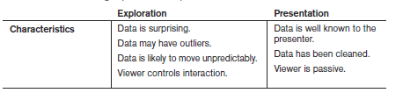
Presentation is Not Exploration
An analyst sitting before a spreadsheet does not know what the data will show and may need to search from multiple angles
This is sometimes a foraging process
When I present data (say a class lecture), I have cleaned the data, I avoid errors in the data, I tell you a story
Animation can help facilitate that story
Fisher, Danyel, “Animation for Visualization: Opportunities and Drawbacks”, Ch. 19 in Steele & Iliinsky (eds.), Beautiful Visualization (Cambridge: O’Reilly, 2010), pp.329-352.

Slide 37
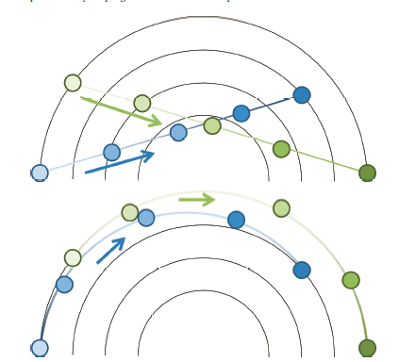
Transitions: Rectangular vs. Polar
Fisher, Danyel, “Animation for Visualization: Opportunities and Drawbacks”, Ch. 19 in Steele & Iliinsky (eds.), Beautiful Visualization (Cambridge: O’Reilly, 2010), pp.329-352.

Slide 38
Principles of Animation
Congruence – marks on the screen must relate to the underlying data at all times
Apprehension – visualization should be easy to understand
Staging – it is disorienting to have too many things happening at once
Compatibility – a visualization that will be disrupted by animation will be difficult for users to track
Necessary motion – avoid unnecessary motion
Meaningful motion – the coordinate spaces and types of motion should remain meaningful
Tversky, B., J. Bauer Morrison, and M. Betrancourt. 2002. ‘‘Animation: Can It Facilitate?.’’ International Journal of Human–Computer Studies 57: 247–62.

Slide 39
Readings and Homework
Required Reading:
J. Heer and G. Robertson. "Animated Transitions in Statistical Data Graphics," IEEE Transactions on Visualization and Computer Graphics Vol. 13, No. 6, Nov.-Dec. 2007, pp. 1240-1247.
Lyn Bartram, Colin Ware, Thomas W. Calvert: Moticons: : detection, distraction and task. Int. J. Hum.-Comput. Stud. 58(5): 515-545 (2003)
Homework
Homework #6 is due in 1 week
Milestone #3 is due in 3 weeks!

